Slide 1
Togetherall welcoming new & returning students
Togetherall is a safe, anonymous, online community for mental health support.
togetherall.com

Slide 2
The community
The Togetherall community is here to help you through difficult feelings you’re experiencing, even if you’ve never felt comfortable talking about them before.
A global, 24/7 community of ordinary
people, moderated by clinical professionals.
People can get (or give) the mental health
support they really need.
No judgement. No stigma.
This is an anonymous place where anyone can begin their journey towards better mental health.

Slide 3
On good days I can support others. On bad days, when I need supporting, I can find information to understand how to deal with it.
Togetherall Member

Slide 4
Togetherall Courses
Find courses specific to your concerns and learn techniques to manage your mental health.
Improve your sleep
A course full of techniques to help sleep, leaving you feel more energized and refreshed
Managing social anxiety
A course which provides techniques and strategies to combat social anxiety and shyness
Stop procrastinating
A course which will help you acknowledge and challenge procrastination and increase your productivity

Slide 5
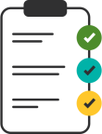
Togetherall Resources
Tools, self-assessments and articles that help you understand how you’re feeling and track your progress.
Journaling tool
Make note of your day-to-day mood in your own journal.
Goal Setting tool
Create and track your personal goals.
Self assessments
Capture how you are feeling and track your progress overtime.

Slide 6
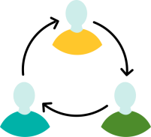
We are having a positive impact:
71%
of members found Togetherall more helpful than other supports they had accessed.
53%
of members felt less isolated as a result of the Togetherall community.
8/10
members found the support from our professionals had helped them.
Source: 2021 Togetherall Impact Report

Slide 7
Togetherall is easy to access
Get free mental health support in minutes, there is no waiting lists to access Togetherall.
1
2
3
4
5
Visit togetherall.com and click 'Register'
Select 'I'm from a university/college’
and enter your academic email address
Complete a few basic questions
You will receive an email to verify your account.
Click on the button within your email to activate your account.
Welcome to the community!

Slide 8
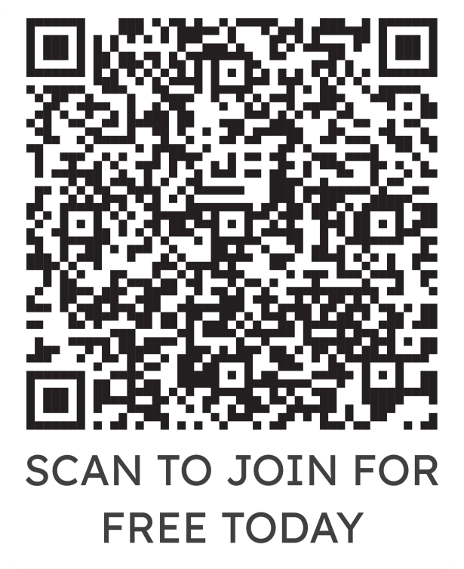
Register today for FREE mental health support
For more details, please refer to our T&C’s during registration

